Slide 1
storytelling_with_data_mentor_file
File created on: 4/2/2023 12:35:12 PM

Slide 2
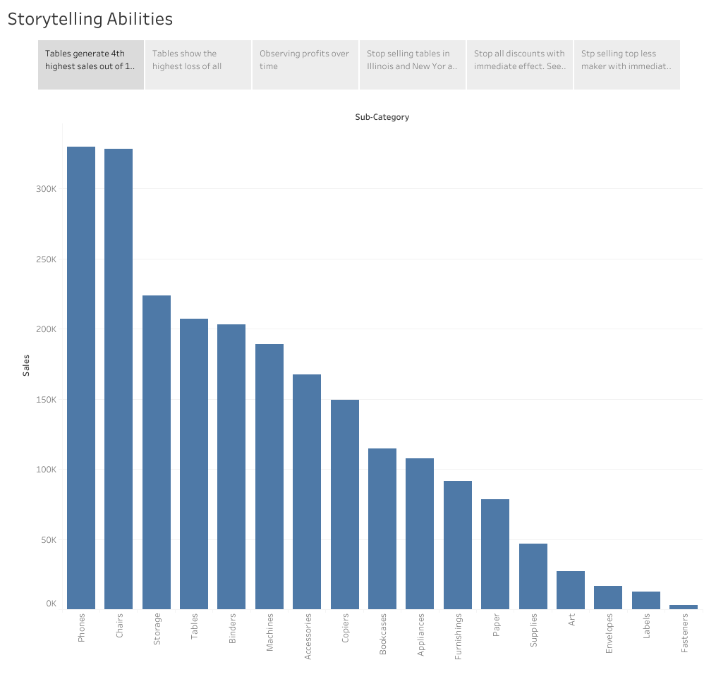

Slide 3
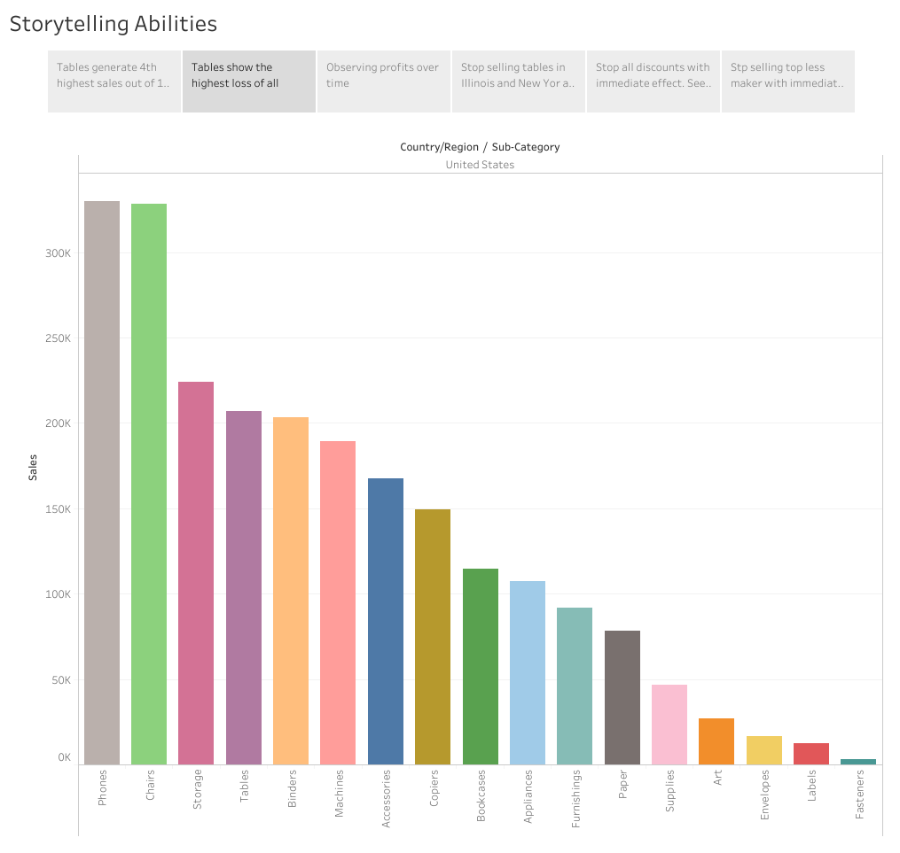

Slide 4
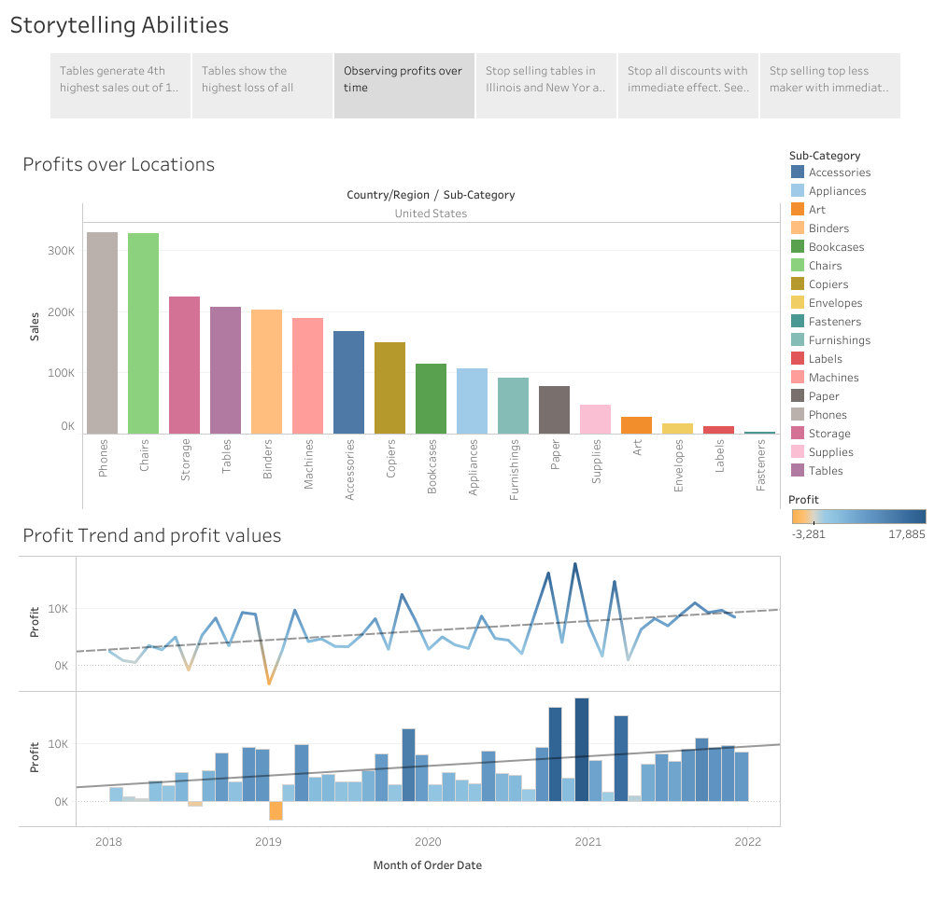

Slide 5
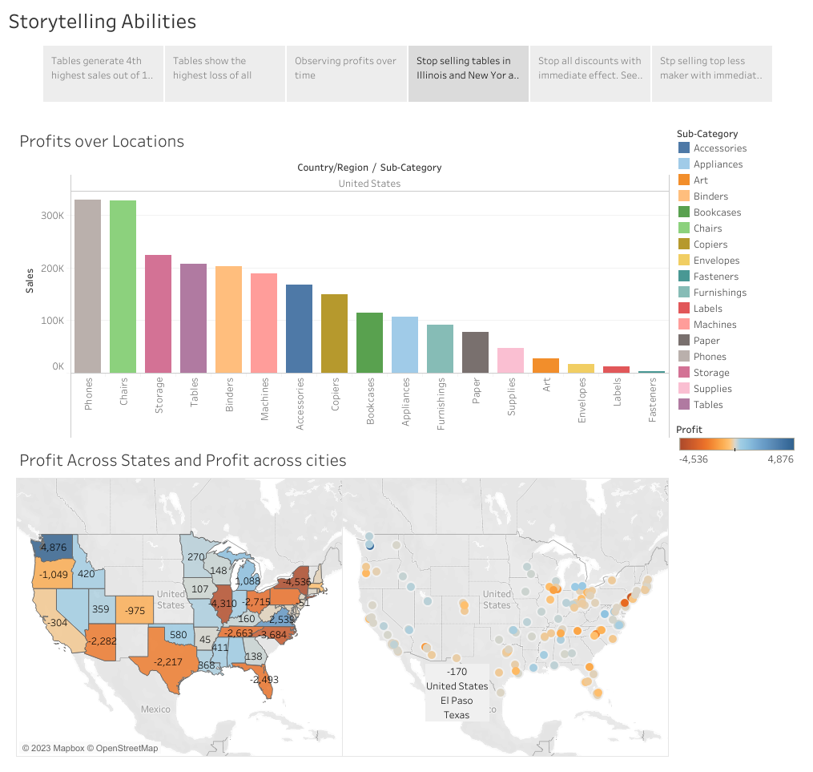

Slide 6
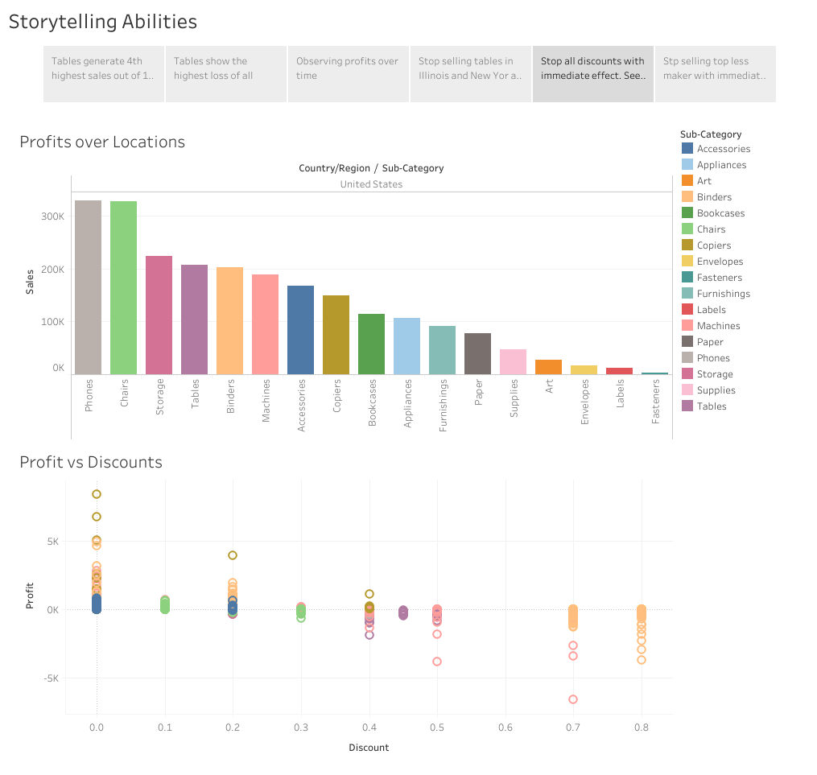

Slide 7
